Slide 1
Amazon Sales Analysis
Ruby Varghese

Slide 2
Agenda
Objectives
Visualizations
Insights
Recommendations

Slide 3
Problem Statement and Objective
With the increasing importance of sales management in commercial and business enterprises, there's a growing need to analyze sales trends and key metrics using data-driven approaches. Extracting, transforming, and loading (ETL) data from Amazon datasets can provide valuable insights into month-wise, year-wise, and yearly-month-wise sales trends. Identifying key metrics and factors and understanding the relationships between attributes can help optimize sales strategies, reduce costs, and increase profits.
The objective of this project is to perform ETL processes on Amazon dataset to extract relevant sales data.

Slide 4
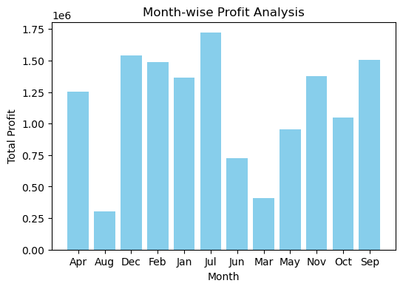
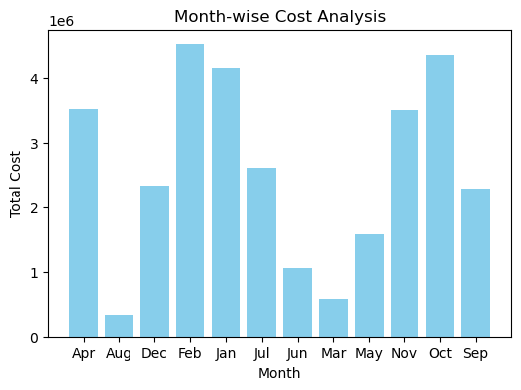
Month wise analysis
The highest profit in the month of July
The highest cost in the month of Feb

Slide 5
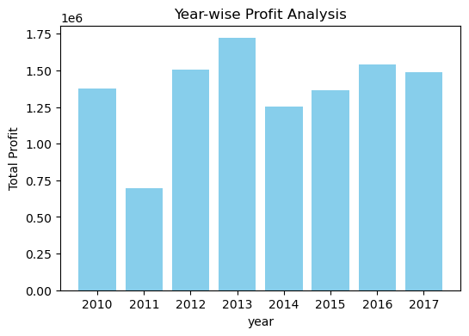
Year wise analysis
The highest profit in the year 2013

Slide 6
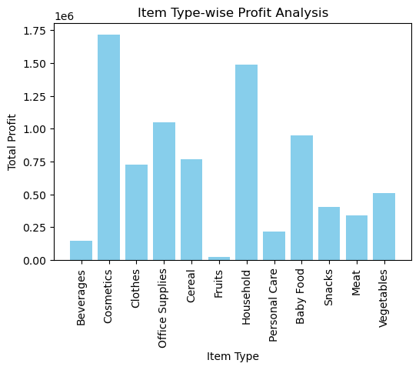
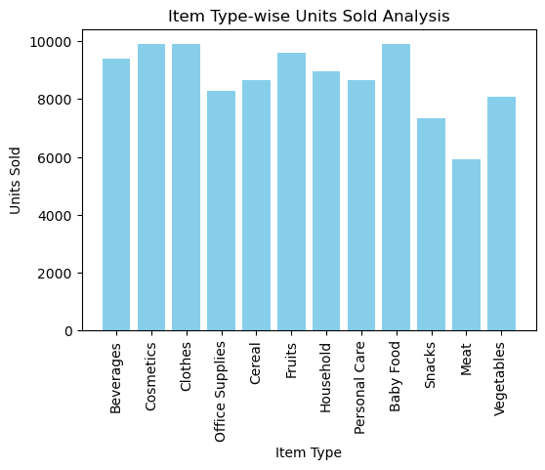
Item Type – wise analysis
The highest profit from Cosmetics

Slide 7
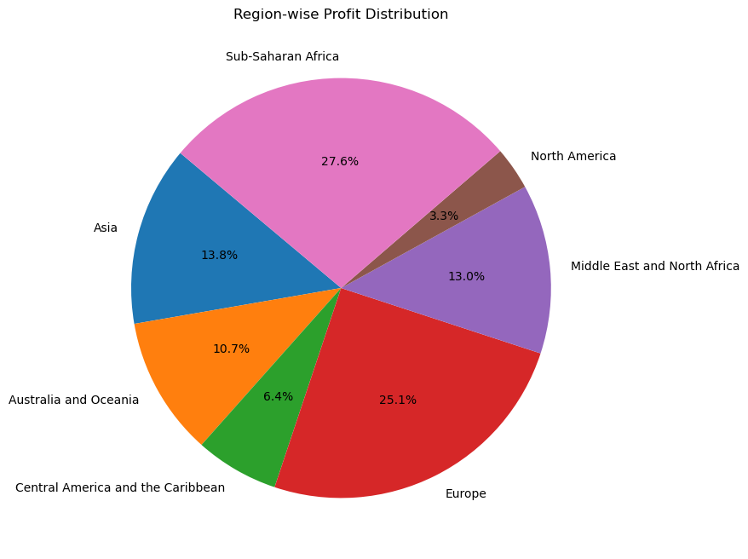
Region-wise Profit Distribution
27.6% of profit from Sub-Saharan Africa

Slide 8
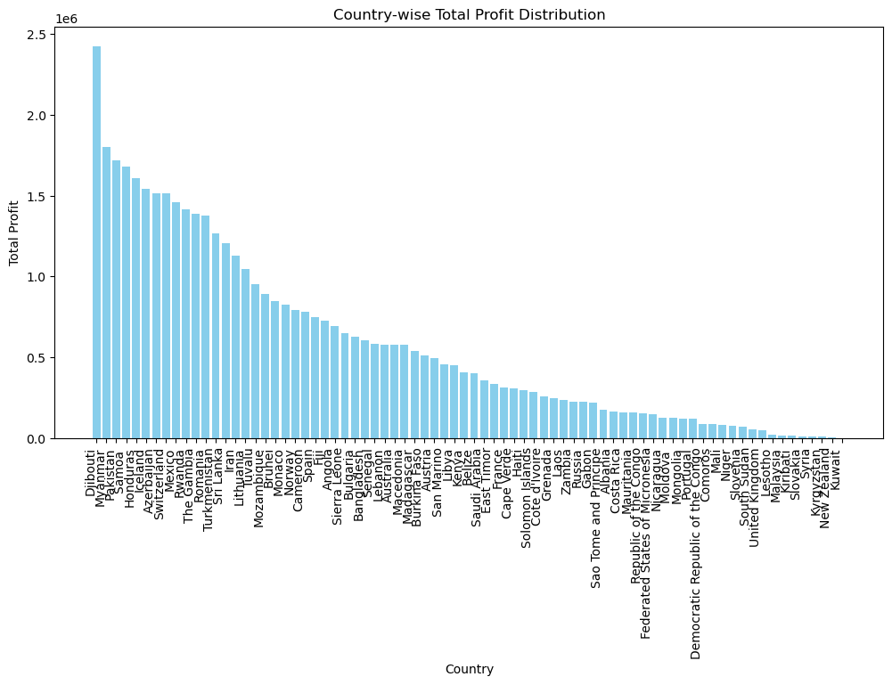
Country-wise Profit Distribution
Highest profit from Djibouti Country

Slide 9
Insights
Highest profit in the month of July and year 2013
The item type Cosmetics is highest selling product in terms of profit.
27.6% of profit from Sub-Saharan Africa Region
Highest profit from Djibouti Country.
Profit and sales are almost same for offline and online sales channel

Slide 10
Recommendations
Given that cosmetics are the highest-selling product in terms of profit, consider expanding the product range within the cosmetics category or investing more in marketing and promotion for these products. Identify trends and customer preferences within the cosmetics market to tailor offerings accordingly.
With 27.6% of profit coming from the Sub-Saharan Africa region, there is significant potential for growth in this market. Explore opportunities to further penetrate this region by understanding local preferences, investing in targeted marketing campaigns, and establishing partnerships with local distributors or retailers.
Since the highest profit comes from Djibouti, focus on optimizing operations and logistics in this country to maintain and potentially increase profitability. This could involve streamlining supply chain processes, ensuring adequate inventory management, and addressing any operational inefficiencies.
Given that profit and sales are almost the same for both offline and online sales channels, it's essential to maintain a balanced approach between the two channels. Monitor customer preferences and market trends to adapt strategies accordingly. Invest in improving the customer experience across both channels to drive sales and profitability.

Slide 11
THANK YOU

